Slide 1

DECENTRALIZED REPLICA MANAGEMENT IN EDGE ENVIRONMENTS WITH LATENCY AND RESOURCE OPTIMIZATION
Guided By
Mrs.K.BHAVEENA, M.E..,
Presented By
SANJAI A (81062110423)
MOHAN K (81062110414)
BALANCHANDHIRAN M (810621104304)

Slide 2
AGENDA
ABSTRACT
PROBLEM STATEMENT
INTRODUCTION
EXISTING SYSTEM
PROPOSED SYSTEM
BLOCK DIAGARAM
SYSTEM REQUIREMENTS
MODULES
OUTPUT
CONCLUSION
FUTURE ENHANCEMENT

Slide 3
ABSTRACT
Decentralized replica management in latency-bound edge environments is critical for ensuring data availability, consistency, and performance while minimizing resource consumption.
This paper presents a novel approach to managing data replicas in edge environments, where strict latency requirements and resource constraints pose unique challenges. The proposed decentralized framework leverages local decision-making algorithms to dynamically adapt replica placement and migration based on real-time workload patterns, network conditions, and resource availability.
By incorporating latency-aware heuristics, the system prioritizes proximity to latency-sensitive applications while balancing computational and storage costs. Extensive simulations demonstrate that the approach achieves significant reductions in resource usage while maintaining low-latency access, making it suitable for applications such as IoT, content delivery, and healthcare.

Slide 4
INTRODUCTION
In recent years, the proliferation of latency-sensitive applications such as Internet of Things (IoT) systems, real-time analytics, healthcare monitoring, and content delivery networks has driven the widespread adoption of edge computing.
By bringing computation and data storage closer to end-users, edge environments significantly reduce communication delays and alleviate the load on centralized cloud infrastructures. However, the decentralized and resource-constrained nature of edge environments introduce new challenges in managing data availability, consistency, and system performance.
Replica management, which involves the strategic placement and movement of data copies across edge nodes, is critical to achieving reliable and low-latency data access. Traditional centralized approaches often fail to scale or adapt efficiently under dynamic workloads and fluctuating network conditions.

Slide 5
PROBLEM STATEMENT
The decentralized edge environments introduce new challenges in managing data availability, consistency, and system performance. Replica management, which involves the strategic placement and movement of data copies across edge nodes, is critical to achieving reliable and low-latency data access.
Traditional centralized approaches often fail to scale or adapt efficiently under dynamic workloads and fluctuating network conditions. These applications often run on distributed, resource- constrained edge nodes with limited processing power, memory, and network bandwidth.
To support data availability and fault tolerance, replication is essential. However, traditional centralized replica management approaches struggle in dynamic and latency-sensitive edge environments.

Slide 6
EXISTING SYSTEM
Depends on a central coordinator, leading to high latency.
Introduces a single point of failure, risking system downtime.
Static replica placement that doesn’t adapt to real-time changes.

Slide 7
PROPOSED SYSTEM
Eliminates central controller, allowing fully decentralized decision making.
Ensures low-latency access by placing replicas closer to applications.
Improves fault tolerance by removing the single point of failure.
Adapts dynamically to real-time workload and network changes

Slide 8
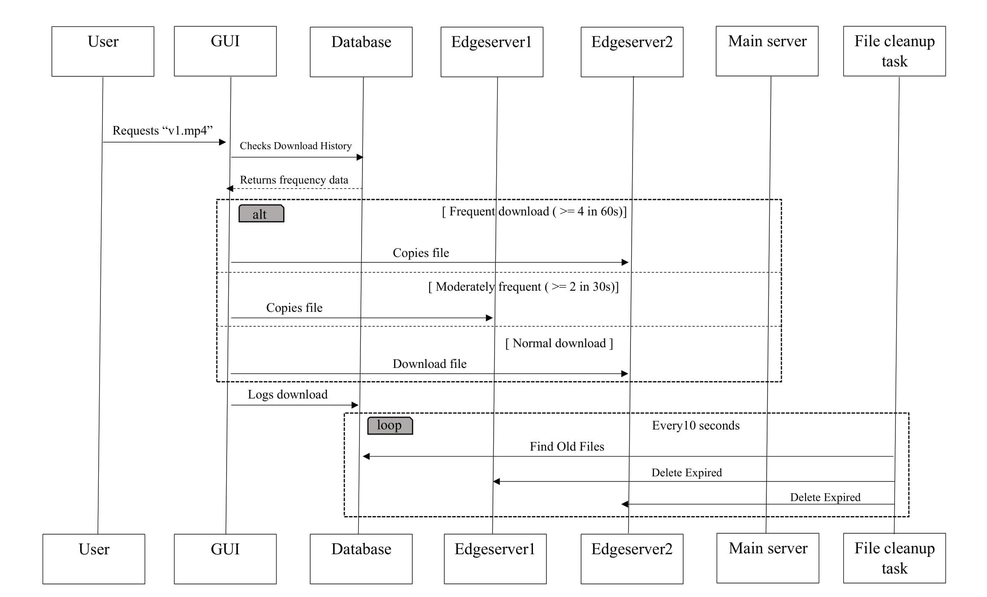
BLOCK DIAGRAM

Slide 9
SYSTEM REQUIREMENTS
HARDWARE SPECIFICATIONS:
Processor : Intel i5 or i7/ AMD Ryzen 5 or 7
Hard Disk : 20GB
RAM : Minimum 8GB (Recommended 16GB)
Operating System : Windows 10/ Windows11

Slide 10
CONT…
SOFTWARE SPECIFICATIONS:
Front End : JAVA 17
Database : MySql
Web Server : GlassFish
IDE : Apache NetBeans 24

Slide 11
MODULES
Replica Management Module
Communication Module
Node Monitoring Module
Decision Engine Module

Slide 12
REPLICA MANAGEMENT MODULE
Function: Handles creation, placement, migration, and deletion of replicas.
Places replicas close to high-demand or latency-sensitive nodes.
Decides which data needs to be replicated and where.
Ensures fault tolerance by duplicating data across multiple nodes.
Deletes replicas when they're no longer needed (clean-up logic).
Maintains consistency between replicas across edge nodes.

Slide 13
COMMUNICATION MODULE
Function: Facilitates peer-to-peer interaction and data sharing between edge nodes.
Enables nodes to communicate without a central server.
Uses REST APIs or socket communication for data transfer.
Ensures secure and reliable transmission of replica metadata.
Handles request/response for replica status, health, or updates.
Reduces latency with direct node-to-node communication.

Slide 14
NODE MONITORING MODULE
Function: Continuously tracks system parameters of each edge node.
Monitors CPU, memory, storage, and bandwidth in real-time.
Detects node overload or failure conditions.
Sends performance data to the Decision Engine.
Helps identify underutilized or overburdened nodes.
Lightweight and runs in the background without affecting performance.

Slide 15
Decision Engine Module
Function: Makes autonomous decisions regarding replica operations.
Uses latency-aware heuristics for replica placement and migration.
Considers current workload, network health, and resource availability.
Decides when to create, move, or delete a replica.
Dynamically adapts to changing edge conditions
(like demand spikes).
Ensures optimal performance with minimum resource usage

Slide 16
REAL-TIME APPLICATIONS
Healthcare Patient data access
Content Delivery Networks
Smart Surveillance Systems
IoT Monitoring Systems

Slide 17
CONCLUSION
The Decentralized Replica Management System effectively addresses the challenges of managing data replicas in resource-constrained edge environments by ensuring low-latency access, high availability, and optimal resource utilization.
The system’s dynamic replica placement and migration strategies adapt to fluctuating network conditions and workload demands, making it highly suitable for data-intensive applications such as IoT, healthcare, and content delivery.
Experimental results demonstrate significant improvements in resource efficiency and system performance across various scenarios.

Slide 18
FUTURE ENHANCEMENTS
Blockchain Integration:
Utilizing blockchain technology can enhance data integrity, auditability, and security in distributed environments, ensuring tamper-proof replica management.
Integration of Machine Learning:
Incorporating advanced machine learning algorithms can enable predictive replica migration and more intelligent resource allocation based on historical and real-time usage patterns.

Slide 19
THANK YOU

